Slide 1
The beer that azure brewed
Scott Corio
https://chronobrew.beer/blog
Infrastructure Architect
Mallinckrodt Pharmaceuticals
Donnie Taylor
http://draith.azurewebsites.net/
Architect
GM

Slide 2
Scott Corio
Donnie Taylor
@scottcorio
@donnie_taylor
A few brewing medals
Microsoft MVP
~15 years
More
Beer, Wood
Beer

Slide 3
How do we make beer?
Mash
Lauter
Boil
Ferment
Drink

Slide 4
Mashing
Malted Barley (sometimes other grains too) are crushed and mixed with hot water
Enzymes created from the malting process begin breaking down starches in the grain into sugar
Temperature during mashing process determines speed and length of the sugar chain
Creates a sugary liquid known as wort

Slide 5
Lautering
Hot water is added to the top of the mash as wort is drained from the bottom
Wort is pushed down and grain is rinsed of any residual sugars
Temperature of water can affect gravity and tannin extraction

Slide 6
boiling
Any residual enzymes are killed off
Hops are added for flavor and armoa
Sugars become more condensed

Slide 7
fermenting
Yeast is pitched into chilled wort
Ale or Lager
Fermentation temperature does not determine if it’s ale or lager
Temperature can make all the difference in the resulting beer
Yeast eats sugar, farts CO2, poops alcohol

Slide 8
Drinking
What we’re all doing now

Slide 9
Recipe generation with Azure Machine Learning

Slide 10
Monitoring yeast bowel movements
Hardware
Raspberry Pi
Tilt Hydrometer
DAQC Plate
DS18B20 Temp Probe
Software
PHP
Python
PowerShell

Slide 11
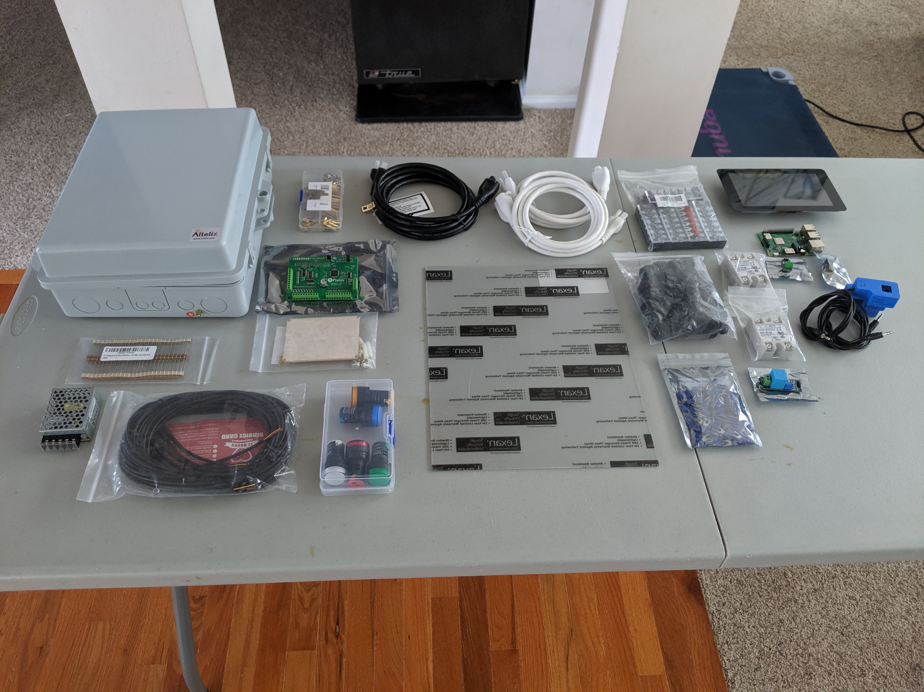
hardware

Slide 12
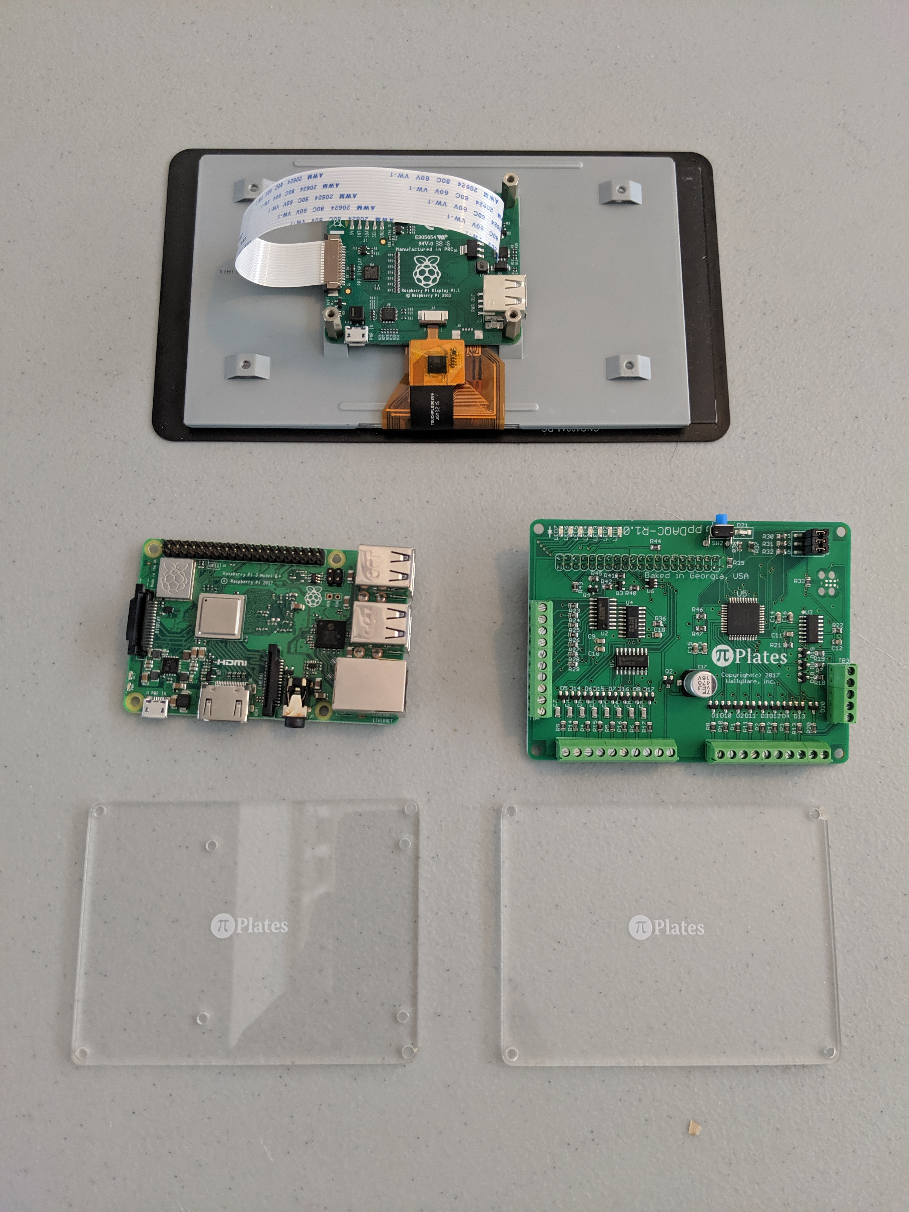
Pi, screen, and Daqcplate

Slide 13
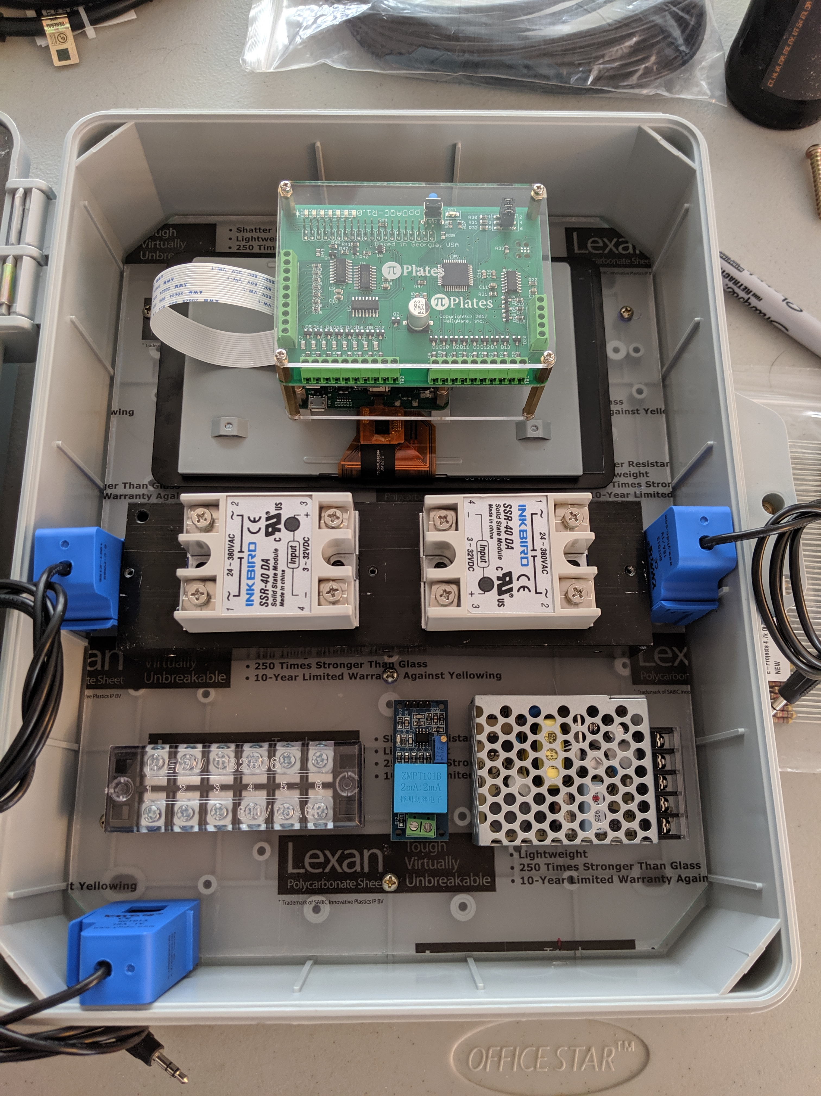
Rough fitting in the enclosure

Slide 14
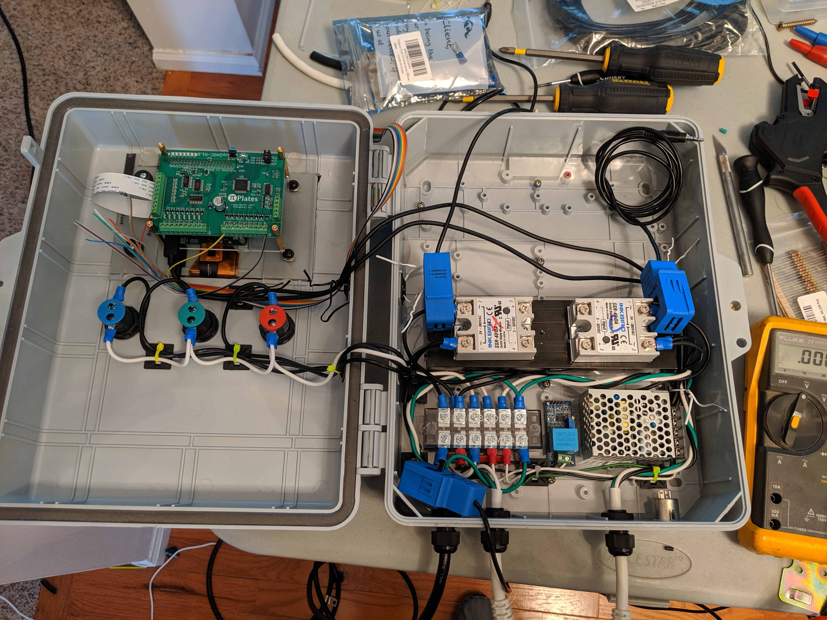
Wiring everything up

Slide 15
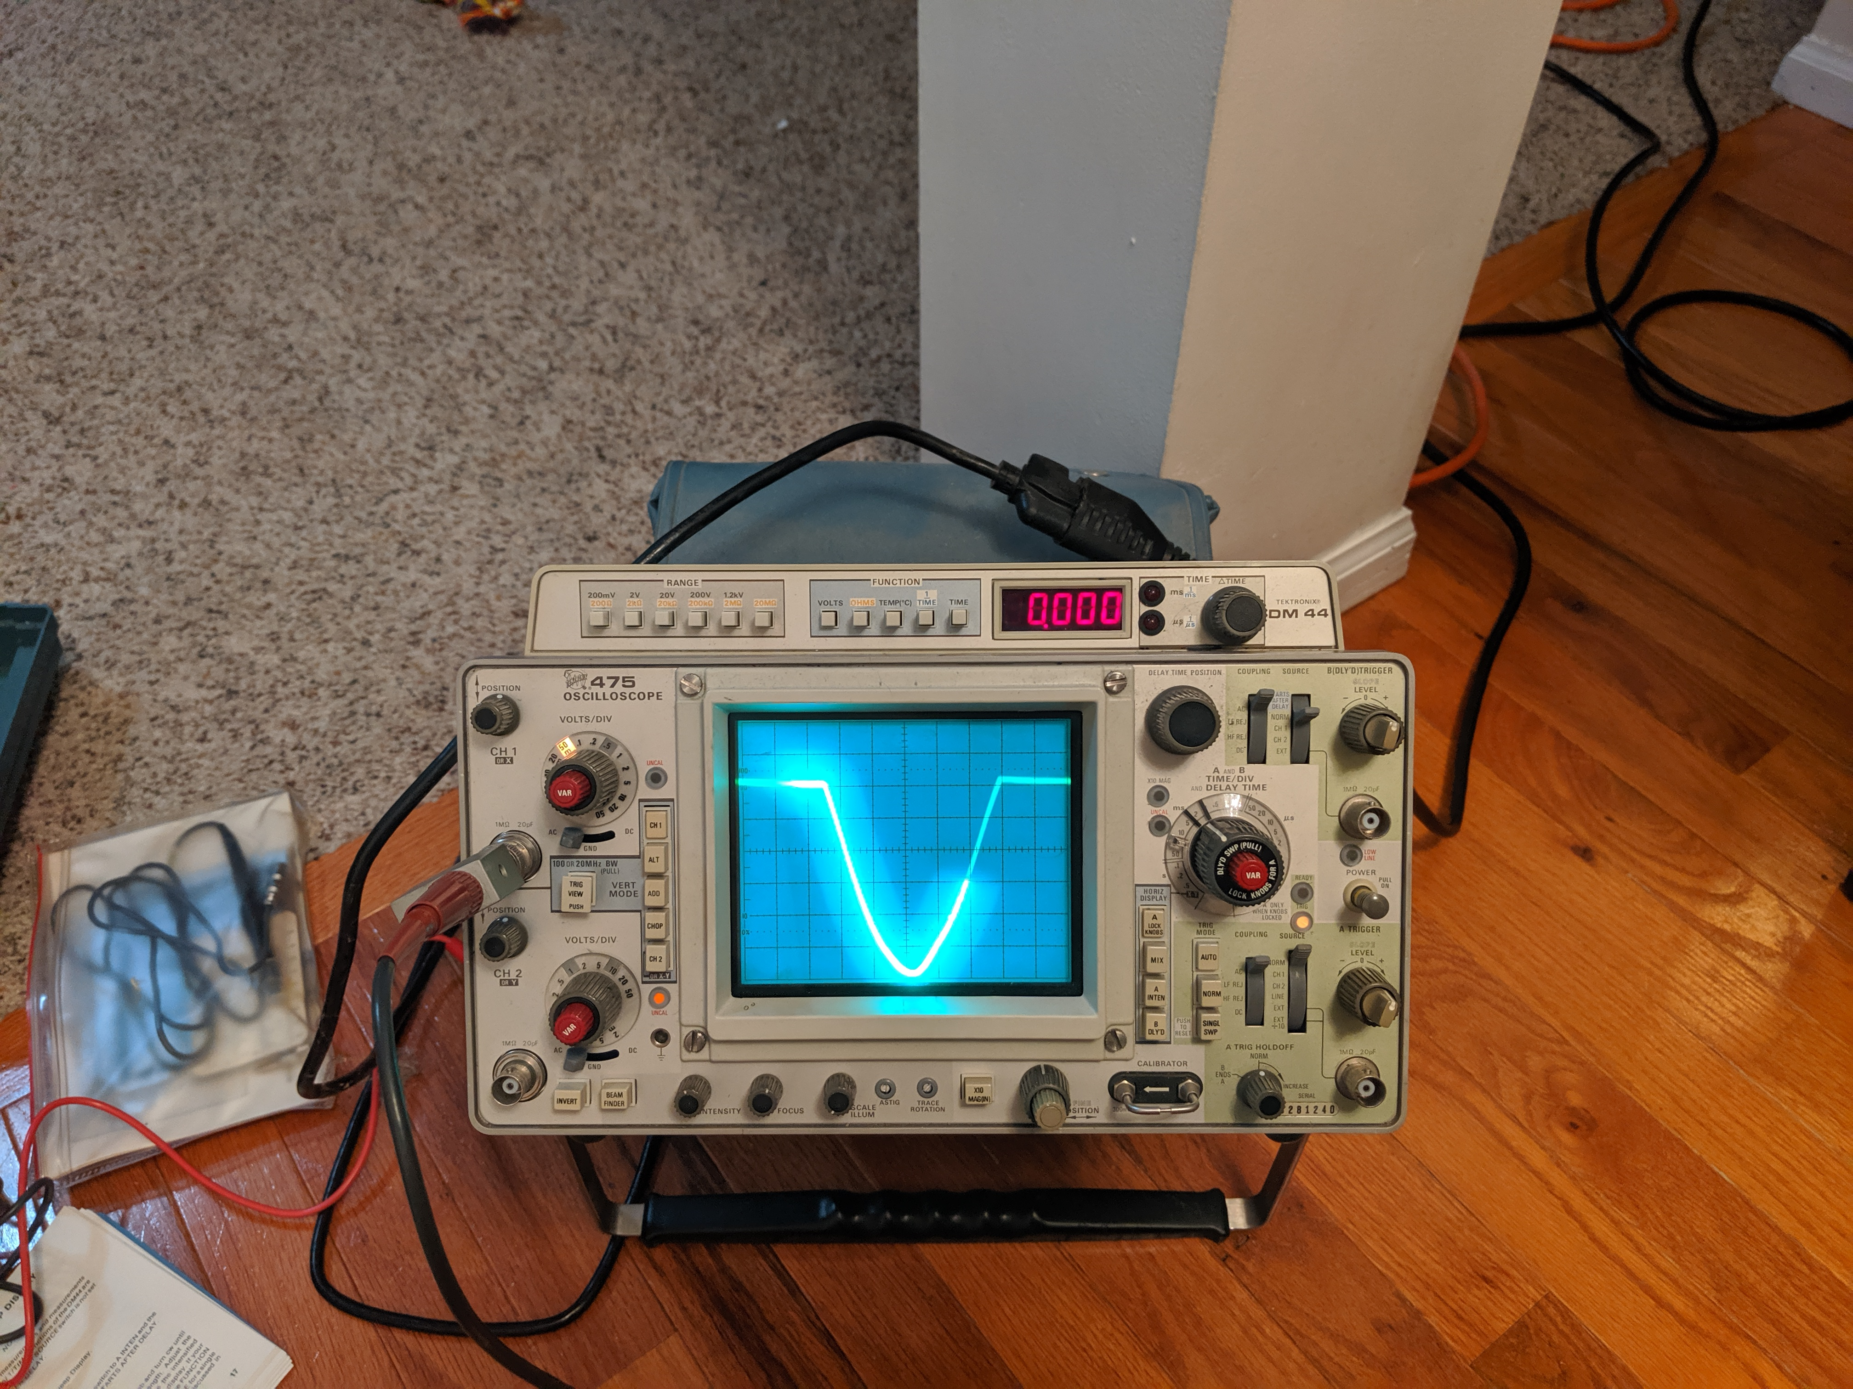
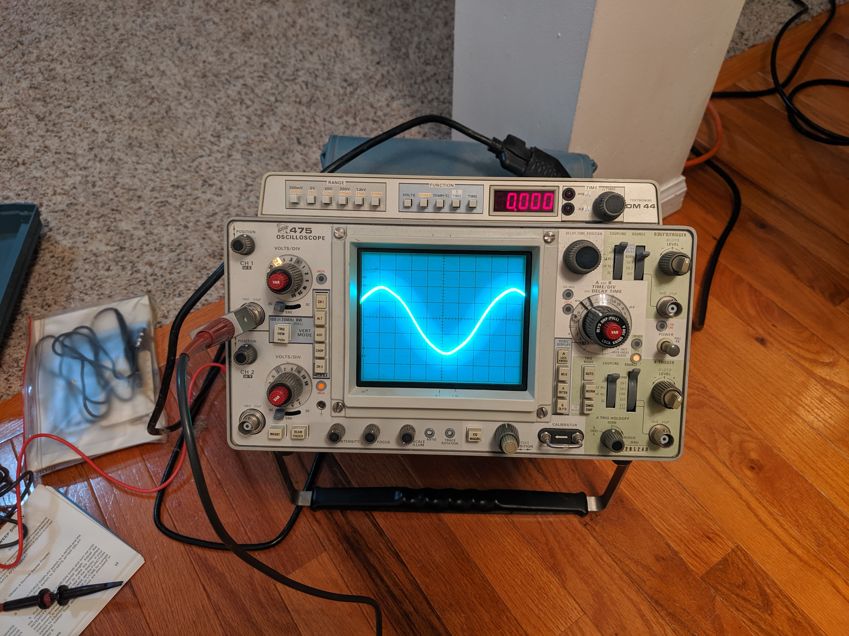
Some calibration required

Slide 16
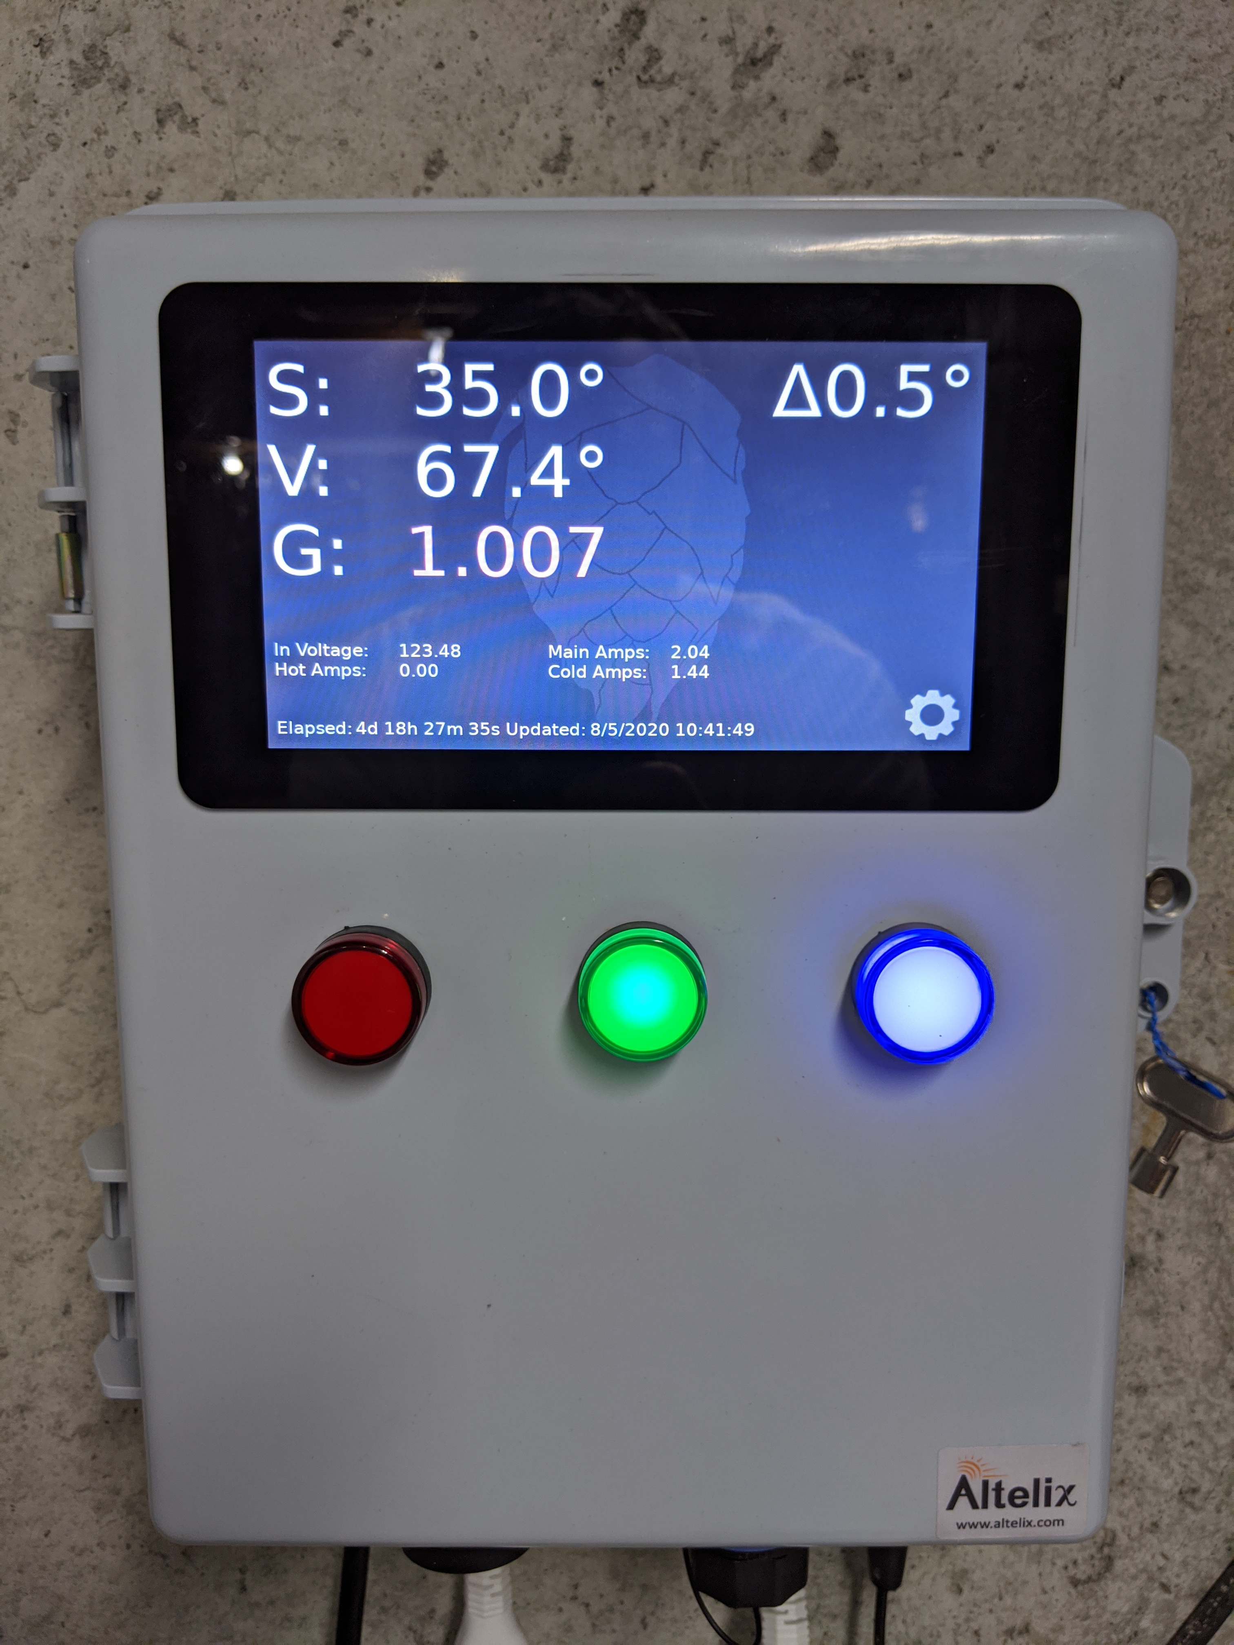
Finished result

Slide 17
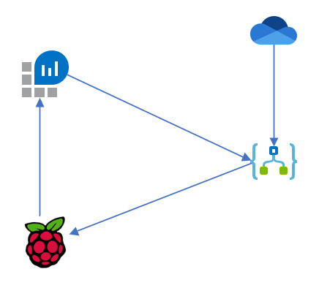
Data flow

Slide 18
Generating Data on the raspberry pi
Temperature, Voltage, and Current are measured using the DAQCPlate via Python
Specific Gravity is measured via PHP utilize Node RED to read BLE data from the Tilt Hydrometer
Data is collated and converted to a JSON payload
JSON is sent to Log Analytics via REST API using PHP

Slide 19
Setting the Temperature and Delta
One Drive notifies Logic App that a file change has occurred
Logic App parses the JSON and creates utilizes a Webhook to send the new data to the Raspberry Pi
Raspberry Pi updates the new files for PHP and Python to read and adjust equipment

Slide 20
Ending Fermentation
Alert in Log Analytics monitors for stable gravity readings
When the average reading is consistent for 3 days, it calls a webhook that tells the fermentation controller to start cold crashing

Slide 23
Section Header
This is the next section

Slide 24
Title
Line1
Bullet Level 1
Bullet Level 2
Bullet Level 3

Slide 25
Title
Code

Slide 26
Text Only with Border
Level 1
Level 2
Level 3

Slide 27
Text Only (Red)
Level 1
Level 2
Level 3

Slide 28
Title
Text 1
Level 1
Level 2
Level 3
Text 2
Level 1
Level 2
Level 3

Slide 29
Title
Section 1
Section 2
Text
Level 1
Level 2
Level 3
Text
Level 1
Level 2
Level 3

Slide 30
Demo Title

Slide 31





























Slide 32






























Slide 33




























Slide 34




























Slide 35




























Slide 36




























Slide 37




























Slide 38























Slide 39
















